Slide 1
CBRM Climate Action Plan Update Workshop
Energy and Mines Minister Derek Mombourquette
January 20, 2020

Slide 2
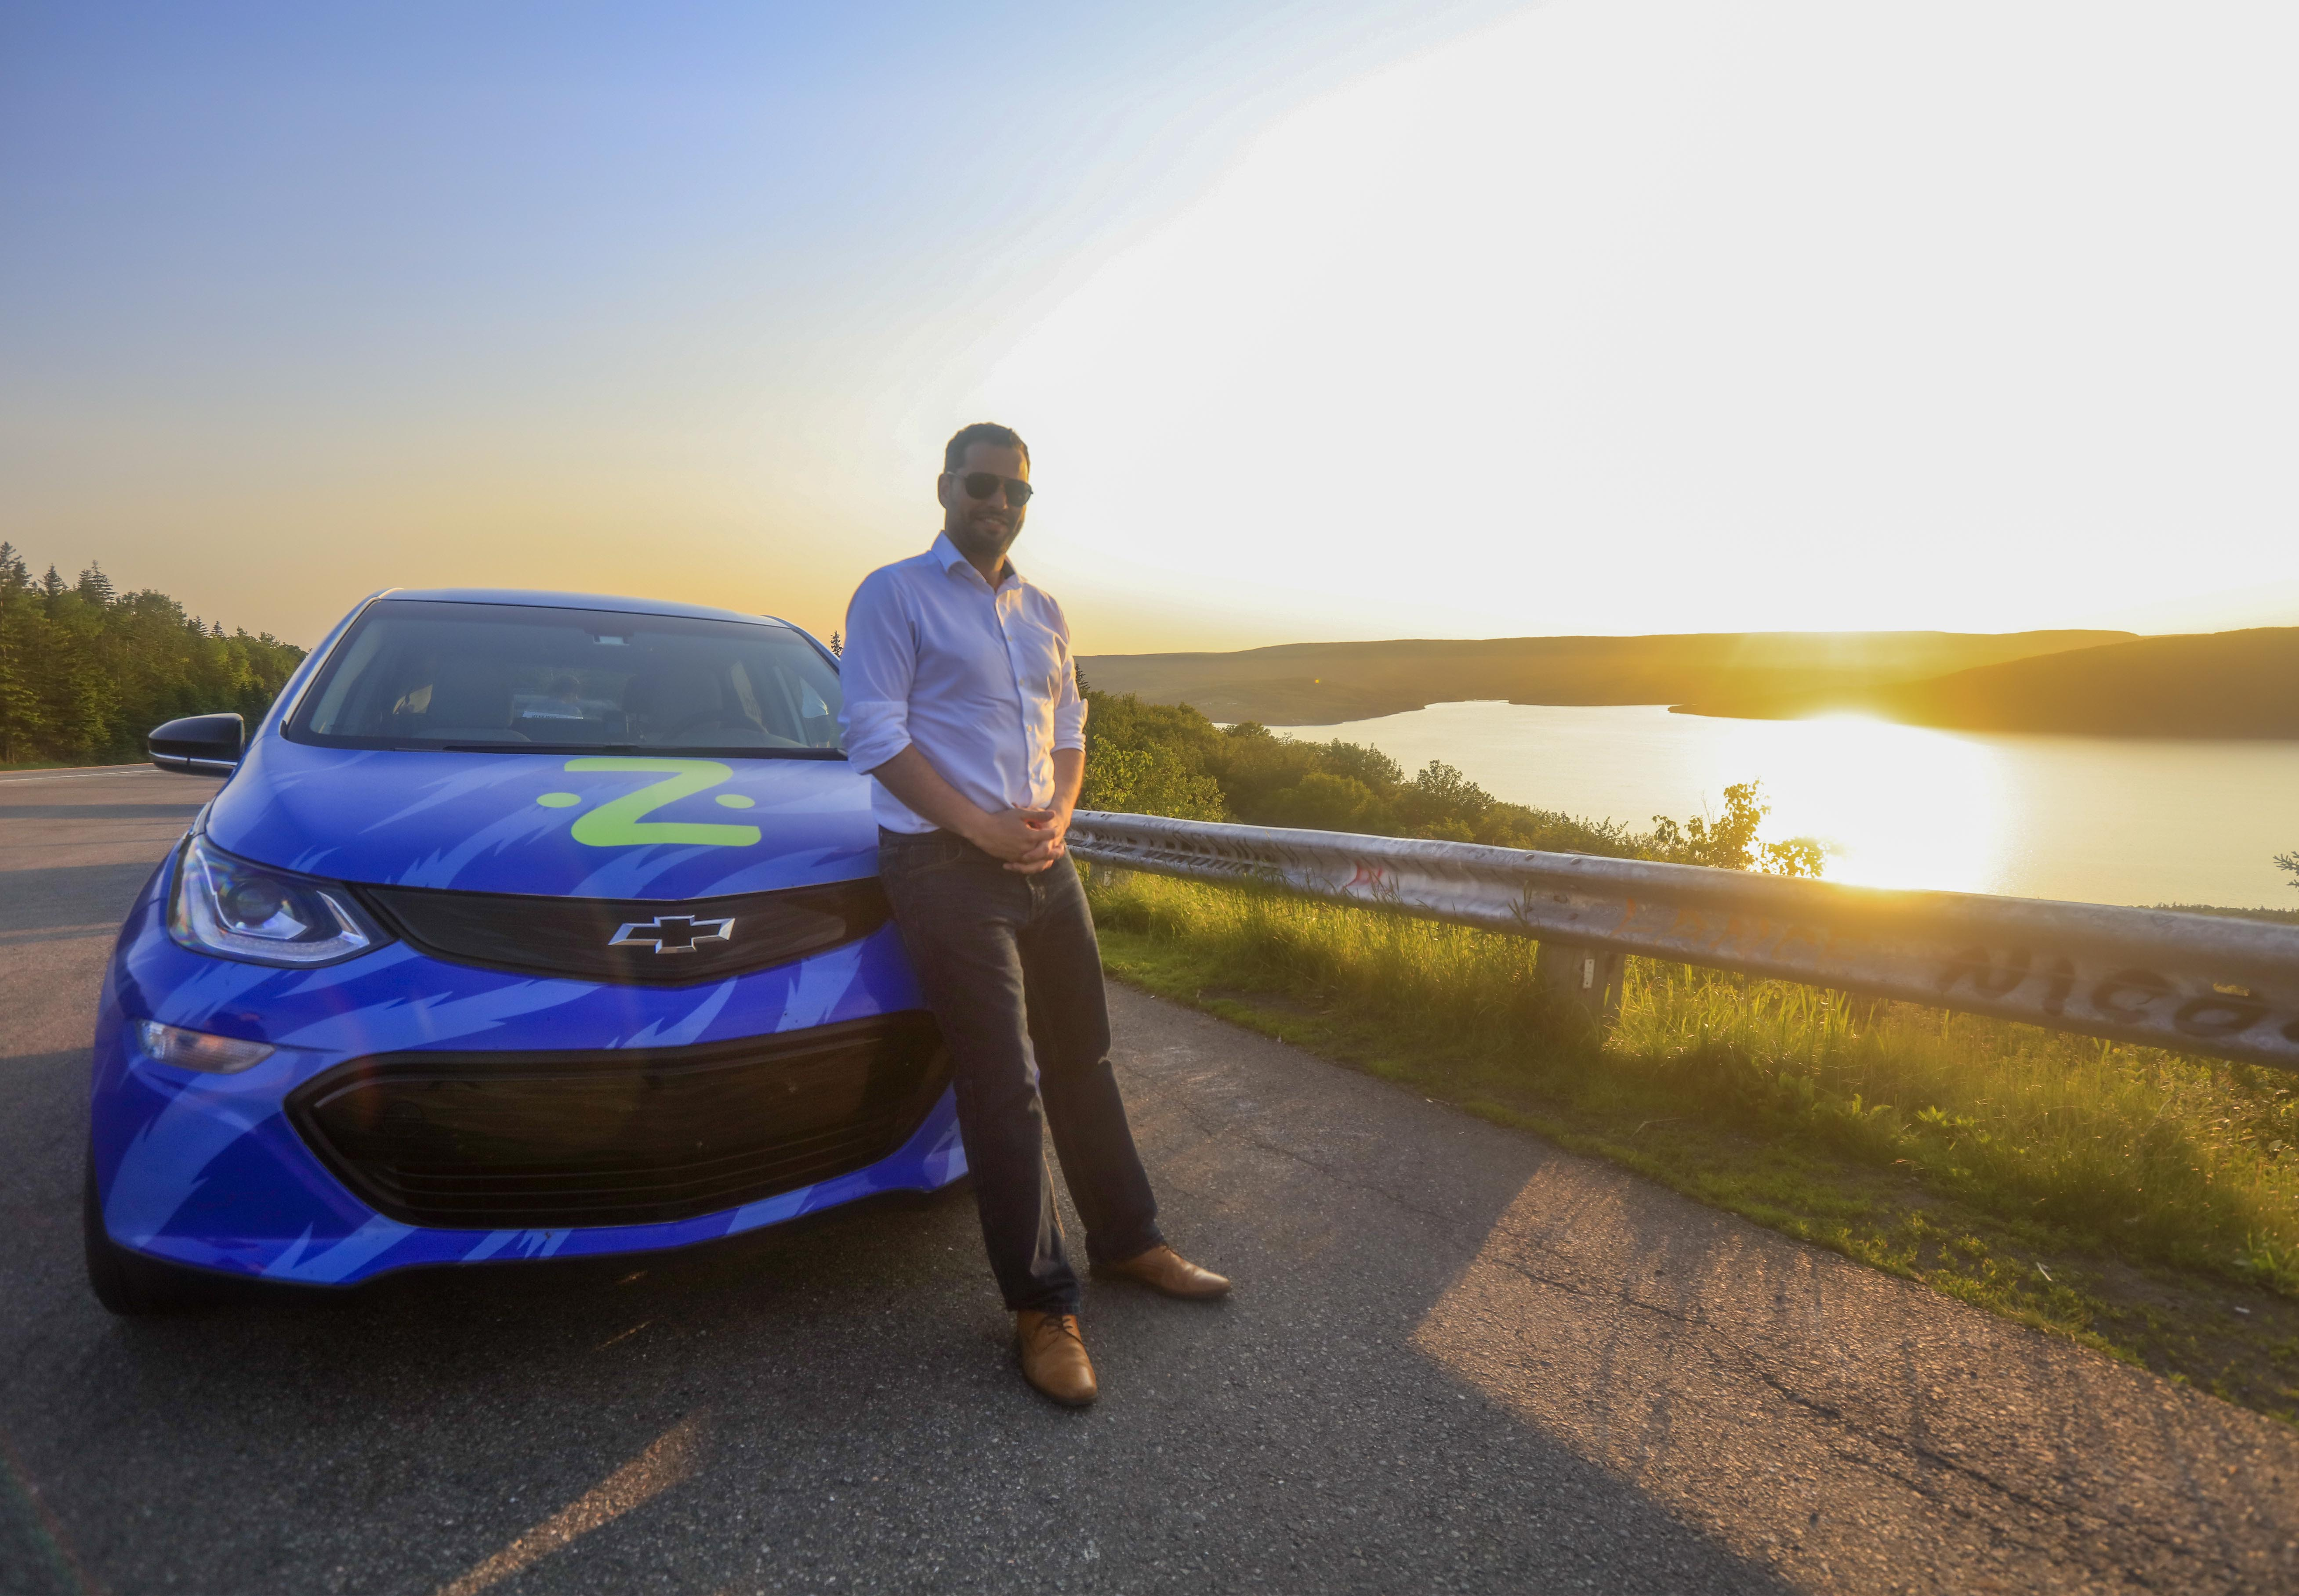
Nova Scotia is a national leader in climate change.
Renewable energy has tripled in the past 10 years and will double again next year.
We hit the federal 2030 target 13 years early.
We are investing $120 million dollars over the next 3 years in programs.
Climate Change Results

Slide 3
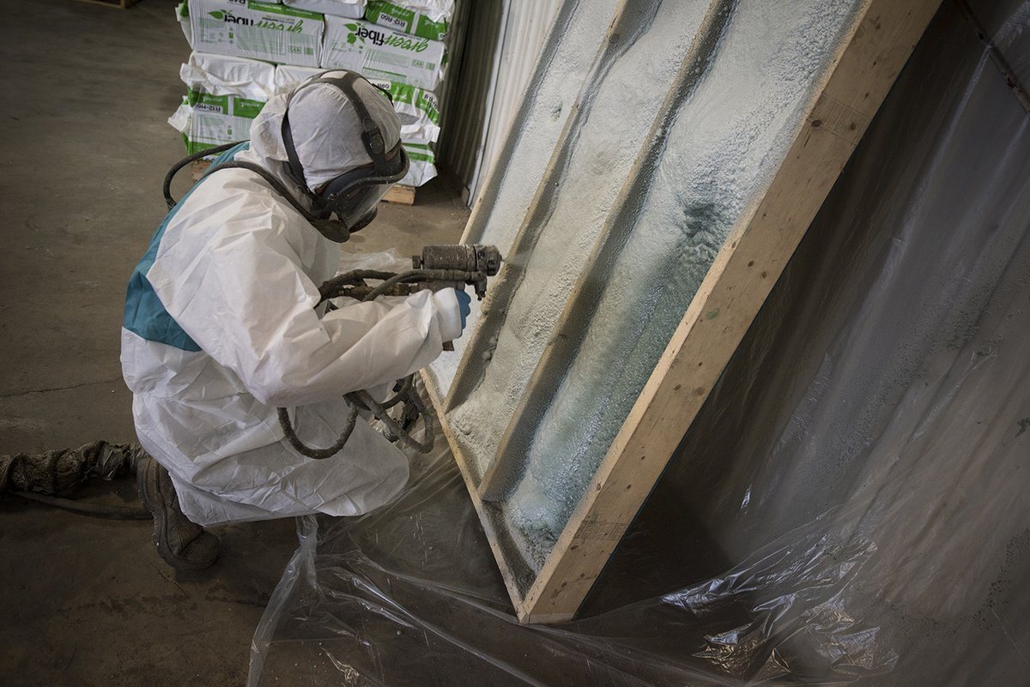
16,000 low income families have had free energy efficiency upgrades. 120,000 homes installed heat pumps.
Department of Energy & Mines is investing $25 million that will upgrade 2400 Mi’kmaq homes and 11,500 public housing units.
1400 employees working for 200 companies.
Energy Efficiency

Slide 4
HomeWarming Program:
(free efficiency upgrades for low-income homes)
Year | CBRM | Richmond | Victoria | Inverness | Total
2013 | 377 | 49 | 17 | 47 | 490
2014 | 357 | 90 | 26 | 36 | 509
2015 | 298 | 74 | 20 | 60 | 451
2016 | 238 | 43 | 25 | 42 | 348
2017 | 212 | 35 | 14 | 35 | 296
2018 | 306 | 33 | 14 | 42 | 394
2019 | 314 | 30 | 16 | 42 | 401
Total | 2102 | 354 | 131 | 304 | 2,890
Provincially funded energy efficiency projects: (includes HomeWarming and other discount programs)
1,738 Cape Breton homes since 2016
589 Cape Breton homes in 2019
Average home saves about $900 a year on energy bills

Slide 5
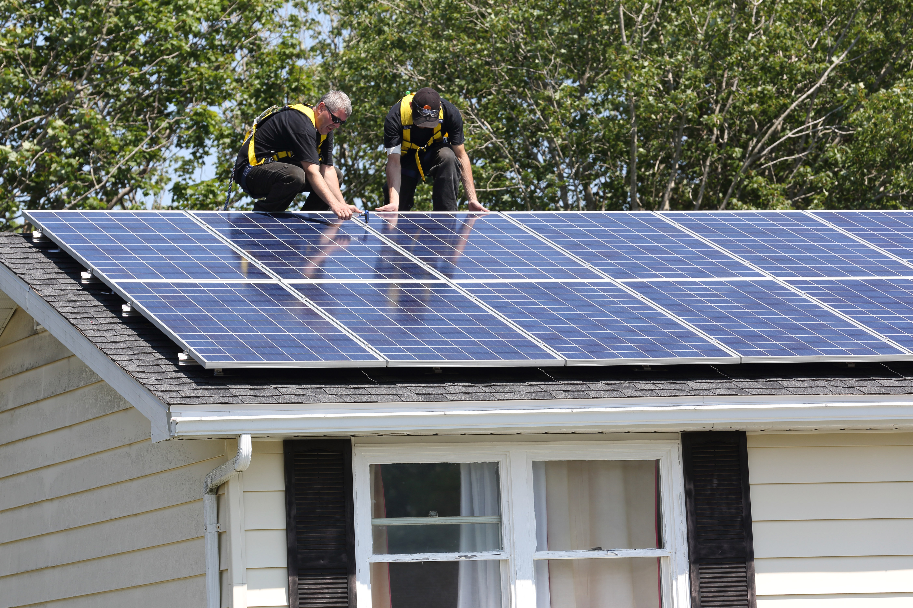
Solar Rebate Program
More than 500 families have added solar electricity to their homes under our SolarHomes rebate.
2018: 13 installers
Today: 57 installers
Currently ranked
best province in Canada
for solar power.
Solar Electricity

Slide 6
SolarHomes Program:
(up to $6,000 rebate on the cost of solar panels)
Over the past 18 months …
160 applications from Cape Breton.
65 Cape Breton homeowners have completed solar installations.
Cape Breton homes have saved more than $535,000 on solar electricity installations.
Cape Breton homes are saving $120,000 a year by using solar electricity.

Slide 7
Solar Electricity for Community Buildings Program:
(enables community buildings to sell electricity)
Cape Breton University, 150 kW (3 x 50 kW)
Cape Breton Christian Education and Service Association, 75 kW
Membertou First Nation, 72 kW
Potlotek First Nation, 72 kW
Eskasoni First Nation, 72 kW
Wagmatcook First Nation, 72 kW
NSCC Strait Area Campus, 75kW

Slide 8
Low Carbon Communities Program:
(projects that reduce emissions – planning, demo projects, etc.)
CBRM – $42,000 for a deep energy retrofit study, led by EAC
CBRM – $15,000 for energy planning for churches led by Verschuren Centre
Cape Breton - $75,000 for 6 Discover Solar sessions, delivered by Solar Nova Scotia
County of Inverness - $60,000 for a community energy plan
CBRM total: $57,000+ for three projects over two years
Cape Breton total – $192,000 for four projects over two years

Slide 9
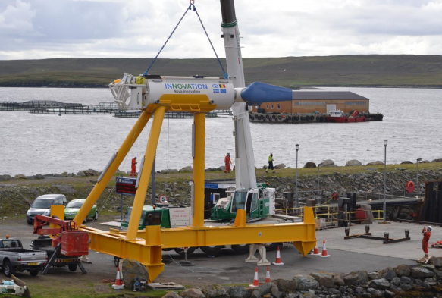
Tidal Energy

Slide 10
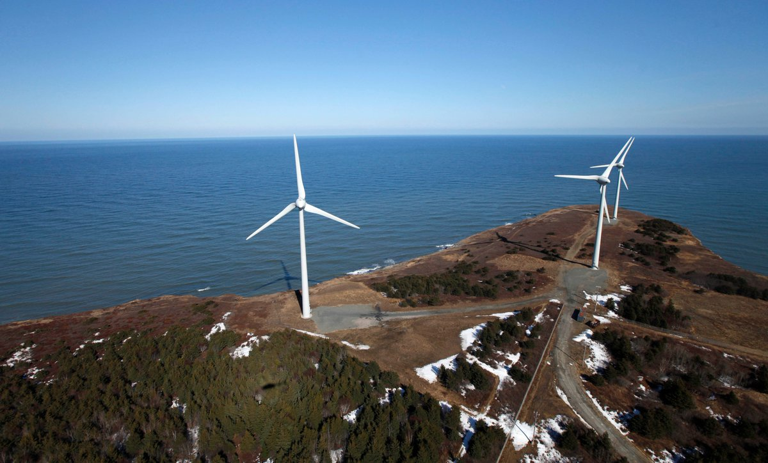
20% of our energy is generated by wind turbines.
Several exciting projects ahead.
Port Hawkesbury Paper working with the Canada infrastructure bank to build 122 megawatt wind farm.
Government of Canada federally own facilities - renewable energy by 2022.
Wind Energy

Slide 11
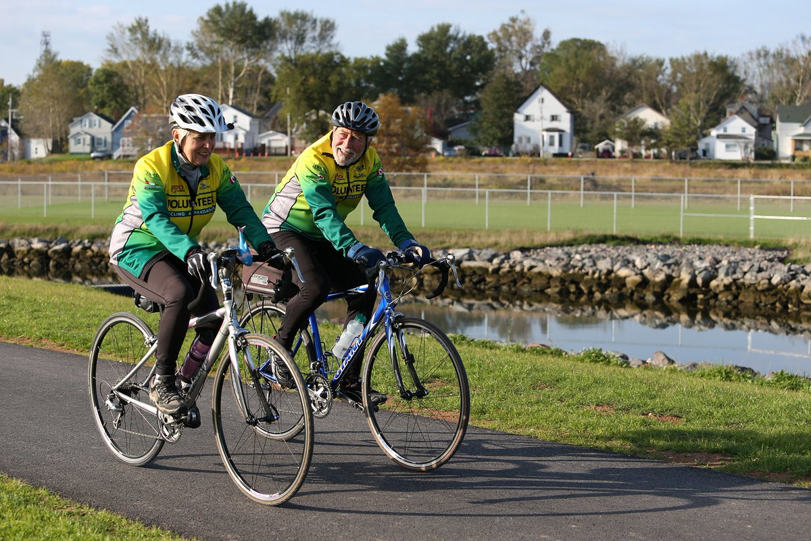
Half of emissions come from transportation sector.
We have invested more than $5.4 million in 140km of projects.
Sustainable Transportation

Slide 12
Connect 2:
(funds community trails for walking, cycling, etc.)
CBRM – $345,000 for the Grand Lake Road multi use path (over multiple years)
CBRM – $150,000 for a multi-use path
CBRM – $65,000 for a pedestrian tunnel and bikeway feasibility study
CBRM – $32,000 for cycling infrastructure upgrades
CBRM – $15,000 for a bike route project
Sydney: $4,000 for a mobility study for students and staff of CBU and NSCC
Cape Breton: $3,000 for planning a walkable communities workshop
Port Hawkesbury: $75,000 for the Destination Reeves Street project
Port Hawkesbury: $20,000 for active transportation development
Victoria County: $55,000 for an active transportation plan and infrastructure
Petit de Grat: $50,000 for active transportation lanes
Petit de Gras: $1,700 for the Old Boudreauville Road Signage Project
Town of Mulgrave: $37,000 for the development of an active transportation corridor
Inverness County: $25,000 for an active transportation plan
Meat Cove: $5,000 for community trails and boardwalks
CBRM total: $611,000 for six projects over seven years
Cape Breton total: $882,000 for 15 projects over seven years

Slide 13
CBRM Opportunities??

Slide 14
Thank you

