Slide 1

Cape Breton
Regional Municipality
General
Capital
2019

Slide 2

“Municipalities own the core infrastructure assets that are critical to the quality of life of Canadians and the competitiveness of our country.
“Municipalities own over 60% of the country’s infrastructure but collect just eight cents of every tax dollar paid in Canada, with the other 92 cents going to Federal, Provincial and Territorial Governments”.
1800 jobs generated per $100million invested in infrastructure
$160million economic growth generated per $100million invested
Federation of Canadian Municipalites (FCM)
Canada Infrastrcuture Report Card
General Capital
2019

Slide 3
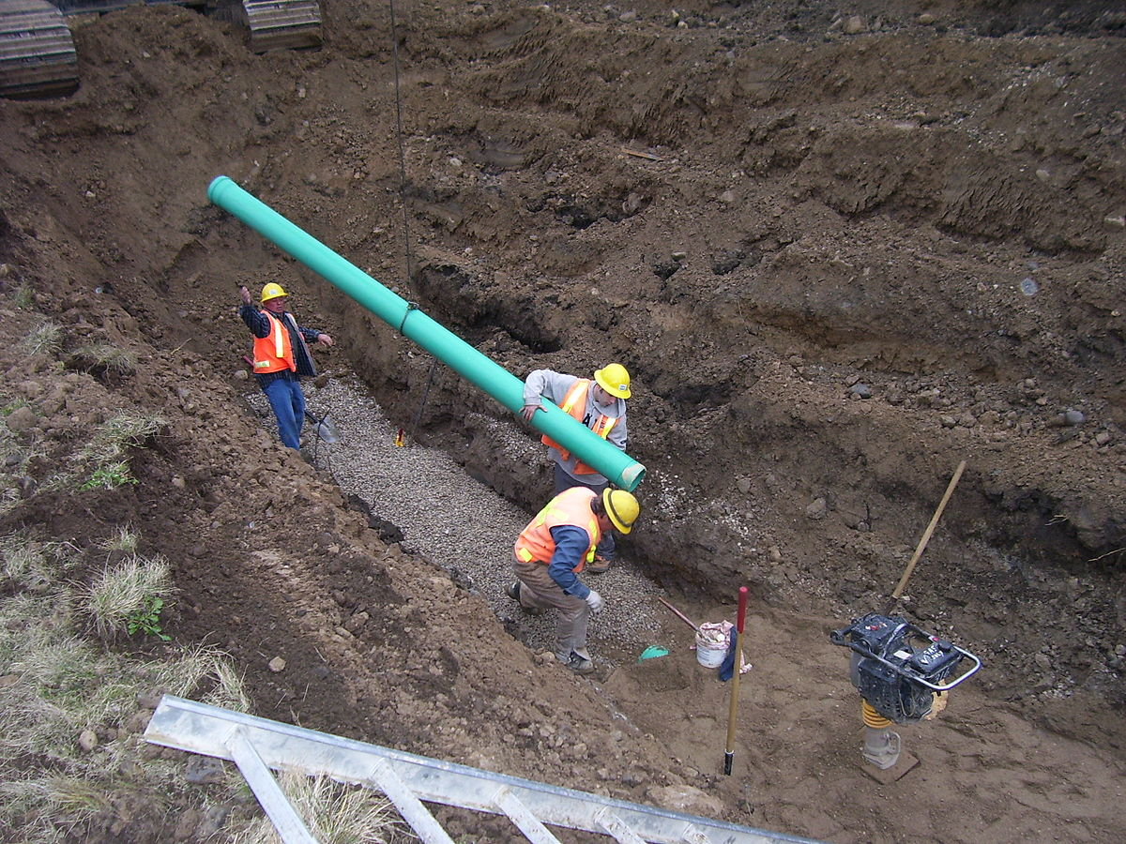
Wastewater
Sydney Harbour West Wastewater Collection & Treatment
$3,000,000 (Carry Over)
This project includes upgrades to the existing sewer collection system and the installation of a new trunk sewer and treatment plant and outfall. Entering year two (Fiscal 2019-20), the focus will be additional soft cost items such as an environmental risk assessment work, collection system investigation and possible upgrades, detailed design work and possibly some construction activity. This project is funded in part by the Province of Nova Scotia and Infrastructure Canada through the Build Canada Fund – Provincial Territorial Infrastructure Component – National Regional Projects.
2018-19 Project Expenditure $400,000
2019-20 Estimated Expenditure $3,000,000
2020-21 Estimated Expenditure $10,400,000
2021-22 Estimated Expenditure $14,101,719
2022-23 Estimated Expenditure $13,501,658
2023-24 Estimated Expenditure $12,201,724
2024-25 Estimated Expenditure $4,402,022
General Capital
2019
Funding Source | Amount | Percentage | Current Fiscal Breakdown Amount
Federal (Gas Tax) | $19,335,708 | 33 | $1,000,000
Provincial | $19,335,708 | 33 | $1,000,000
CBRM | $19,335,708 | 33 | $1,000,000

Slide 4
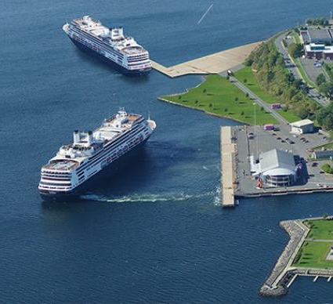
Second Marine Berth
NBC – Small Community Fund
Total Project - $20,000,000
Federal - $5,377,747
Provincial - $5,377,747
CBRM - $4,279,749
Year 3 of 3 $15,035,243
General Capital
2019

Slide 5
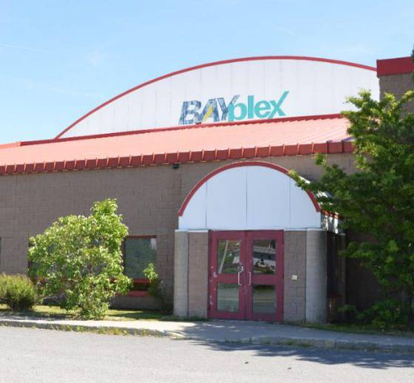
Glace Bay Arena
NBC – Small Community Fund
Total Project - $9,000,000
Federal - $1,500,000
Provincial - $1,500,000
CBRM - $1,500,000
Year 2 of 3 $4,500,000
General Capital
2019

Slide 6
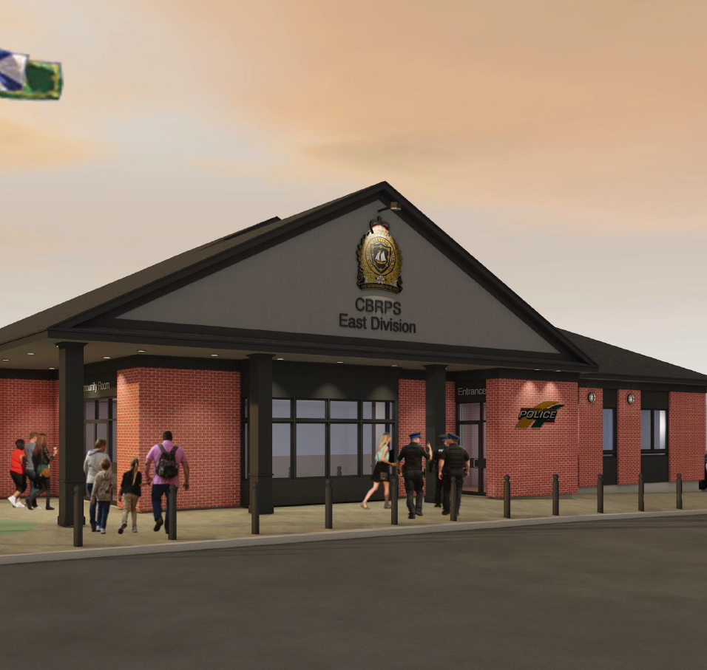
CBRPS Building – East Division
Total Project - $3,100,000
2019 Year 2 of 2 $2,750,000
General Capital
2019

Slide 7
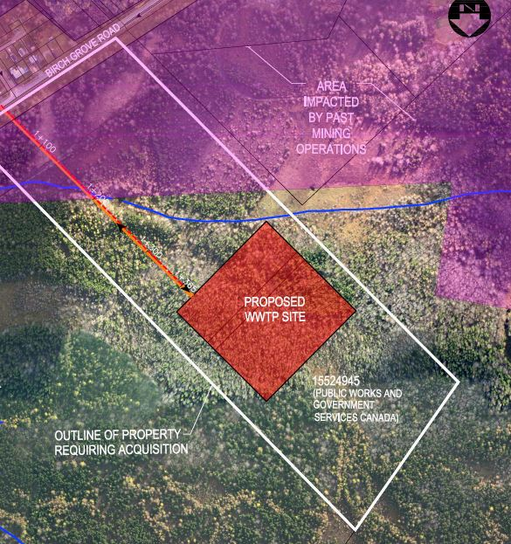
Wastewater
ERA & Pre-Design Project of seven future treatment systems
$341,288.31 (Carry Over)
This program will occur over three fiscal years (2017-18, 2018-19 & 2019-20). The project scope is to establish conceptual treatment system designs that will dramatically improve the Municipality’s understanding of the physical challenges and costs to provide safe, reliable, sustainable, cost effective and environmentally responsible wastewater treatment services to the residents within seven communities of CBRM (Donkin, Port Morien, Glace Bay, New Waterford, Northside, Louisbourg, and New Victoria). This project is funded by the Province of Nova Scotia and Infrastructure Canada through the Building Canada Fund – Major Infrastructure Component.
2017-18 Actual Expenditure $100,990
2018-19 Projected Expenditure $1,039,889
2019-20 Projected Expenditure $341,288
General Capital
2019
Funding Source | Amount | Percentage | Current Fiscal Breakdown Amount
Federal | $494,056 | 33 | $113,762
Provincial | $476,659 | 32 | $109,756
CBRM | $264,425 | 18 | $60,887
Other (Gas Tax) | $247,028 | 17 | $56,881

Slide 8
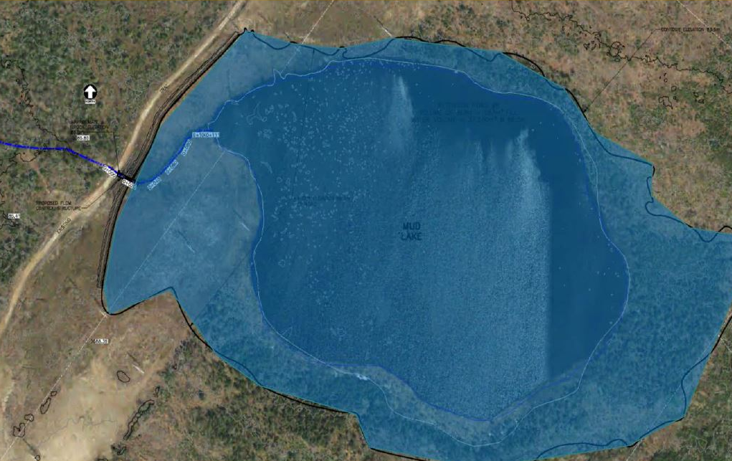
Wastewater
Wash Brook Floodwater Intensity Mitigation Project
Mud Lake Flow Control Structure (FRIIP)
$473,000 (Carry Over)
The purpose of this funding is to construct the Mud Lake Flow Control Structure which is part of CBCL’s recommended flood reduction option number 15, established through the 2017 Wash Brook Flood Containment and Intensity Mitigation Project. This project was approved in the 2018-19 Capital Budget however, it will be carried over into the 2019-20 fiscal year due to a delay associated with a property expropriation. The project is funded, in part, by the Province of Nova Scotia, through the Flood Risk Infrastructure Investment Program (FRIIP)
2018-19 Expenditure - $0
2019-20 Expenditure - $473,000
MUD LAKE
STREAM OUTLET FLOW
CONTROL STRUCTURE
General Capital
2019
Funding Source | Amount | Percentage | Current Fiscal Breakdown Amount
Federal (Gas Tax) | $255,500 | 54 | $255,500
Provincial | $217,500 | 46 | $217,500
CBRM | - | - | -

Slide 9
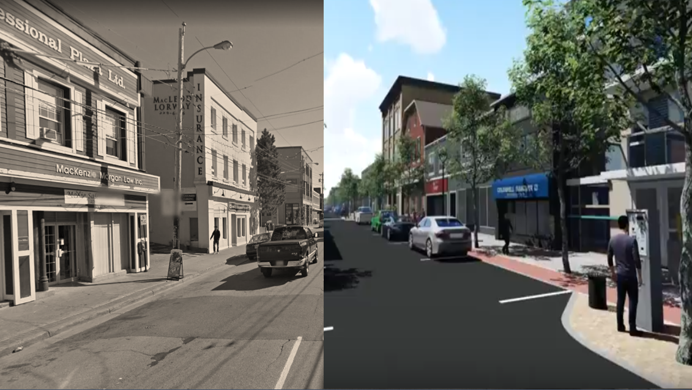
Charlotte Street Redesign
In 2017, CBRM Council endorsed in principal, a concept plan revitalizing downtown Sydney, prepared by the consulting firm Ekistics. The plan recognized that in the near future Charlotte Street would require major infrastructure upgrades including new sub-grade, asphalt, sidewalk/curb repairs and a new waterline. Ekistics recommended that in addition to these basic upgrades, CBRM also reconfigure the street to create a more attractive, pedestrian friendly environment. Proposed improvements included wide sidewalks, underground wiring and the addition of amenities including trees, street furniture and better lighting.
In 2018, it was proposed that an Engineering firm with expertise in infrastructure design be retained to review the Ekistics concept and, in consultation with CBRM staff, Council and the downtown business community, develop plans and specifications for a complete redesign of Charlotte Street. The work would include cost estimates, a phasing plan and the preparation of tender ready documents.
The final concept design/specifications will form the basis for applications sourcing funding partners to allow for a future construction project.
General Capital
2019
Total Design Cost $188,236
2019 – ACOA $44,118 CBRM $44,118
Year 2 of 2 $88,236

Slide 10
Proposed Gas Tax Roads Paving 2019 - $6,400,000
CBRM has in excess of 300 Roads identified for rehabilitation on our current lists. We are operating under the basic principal of “worst first” in formulating a cost effective and pragmatic work plan for 2019 construction season.
This Program would allow for the rehabilitation of 8 Collector Roads & 22 Local Streets.
Central Division
Shandwick Phase 2 (Tain to Bentinick)
Linview Drive (Lingan Loop)
Worgan Street (Kings to Leonard)
Lower Dominion Street (St. Anne to end)
Beech Street (Welton to Vulcan)
Colby Street (George to Rockdale)
French Street (#150 to Gunn)
Kitchener Street (Gunn to end)
Herbert Street (Ainsley to Cornwallis)
Highland Street (George to Rockdale)
Cartier Street (Ashby to Ainsley)
Ortona Street (George to Esplanade) Vulcan Avenue (Forrest to Maple) Charlotte Street (Desbarres to Amelia)
East Division
Hulmes Lane (Roaches Rd to end)
Manfield Street (Lorway to Emery)
Hill Street (Sterling west to end)
George Street Phase 2 (Mt Carmel to Wilson)
Morley Avenue (Waterview to Mahon)
Poplar Street (full length)
Woodward Street (tracks to end)
Dominion Street (Brookside to Highland) Main Street (Deanna to Cadegan) Beacon Street (Reservoir to Wallace)
North Division
Cottage Street (Purves to end)
Forrest Street (Butts to King)
York Street (George to graveyard)
Court Street (Stanley to Pierce)
LeGatto Street (Pitt to Atlantic) Fraser Avenue (Main to Shore)
General Capital
2019
Total $6,400,000

Slide 11
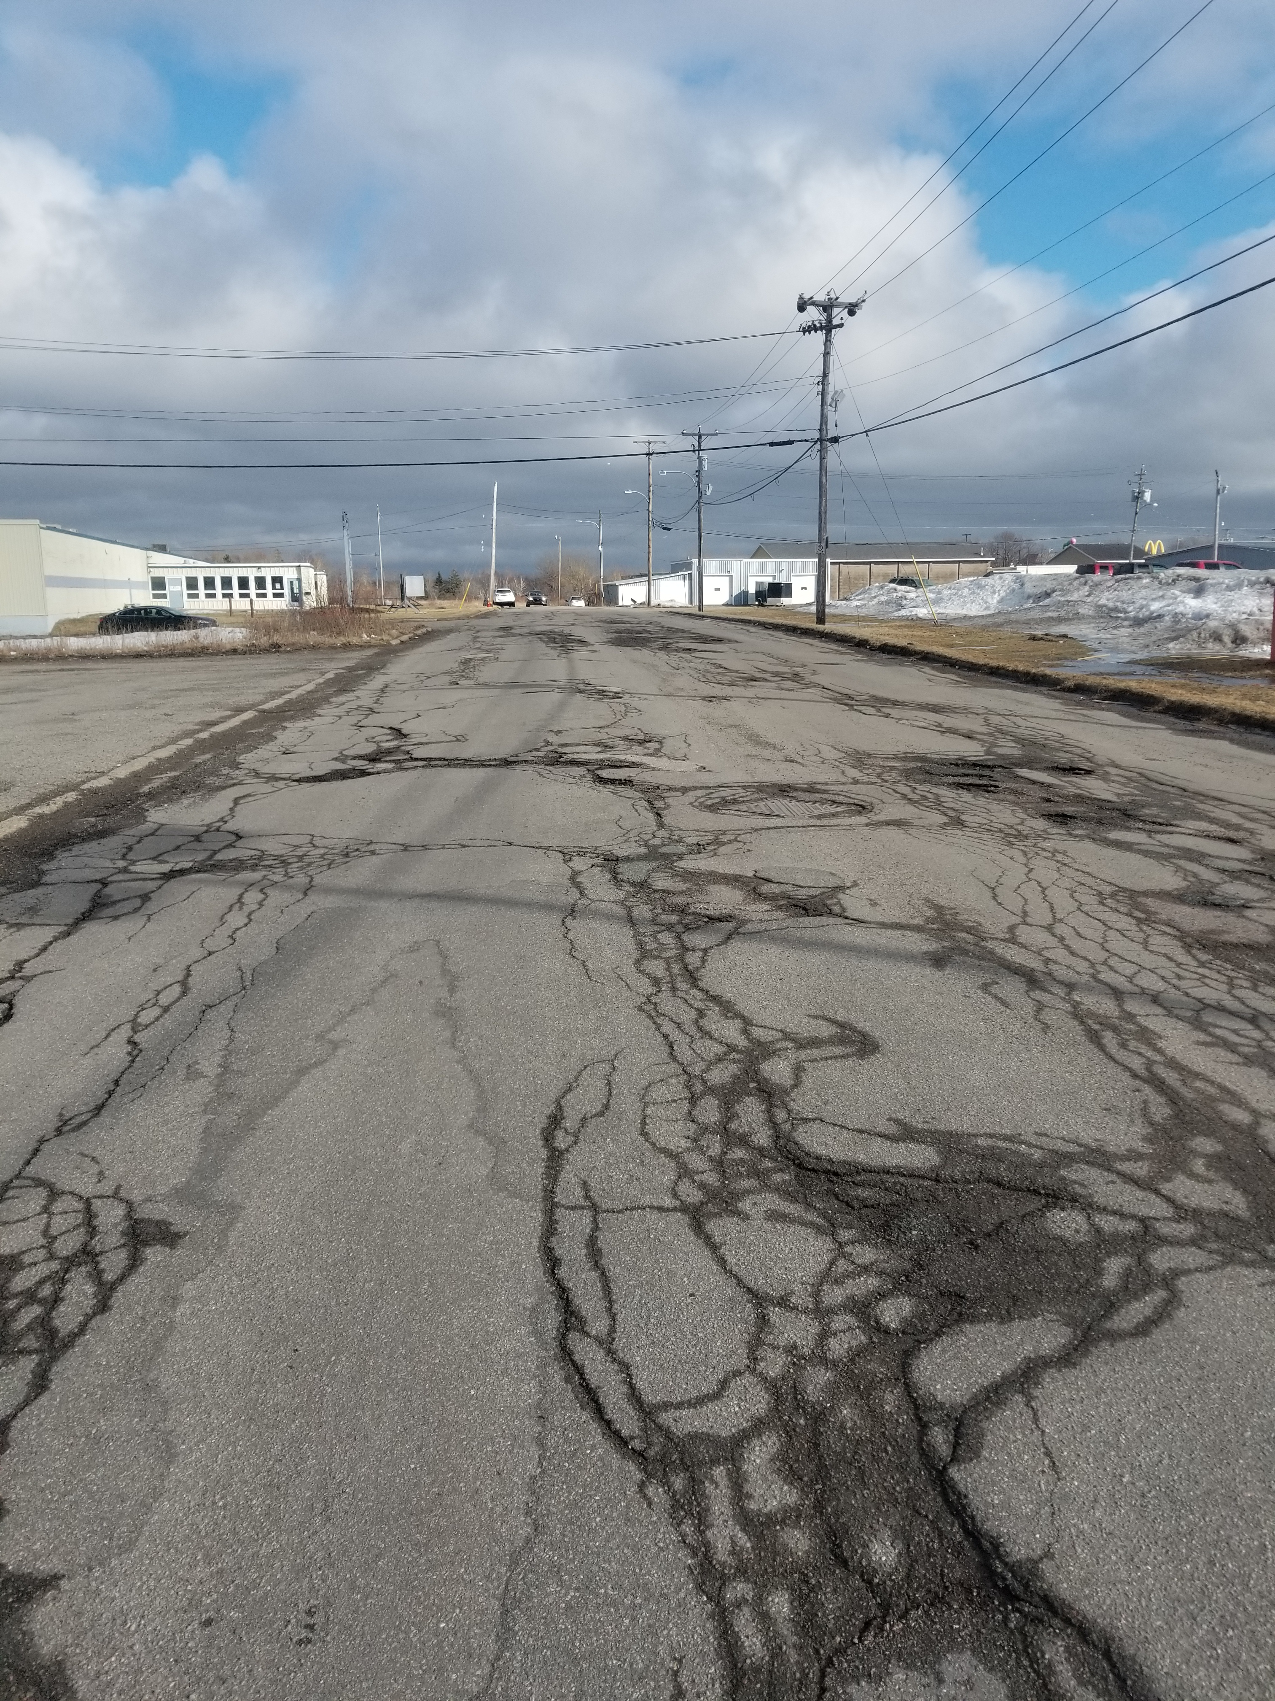
Proposed Road Rehabilitations 2019-2022 ‘ICIP’ Paving
CBRM has in excess of 300 roads identified for rehabilitation on our current list. We are operating under the basic principal of ‘worst first’ in formulation a cost effective and pragmatic work plan for 2019-2022.
In anticipation of a “call for applications” under the “Rural & Northern Communities and Infrastructure Stream” of the New Building Canada – Investing in Canada Infrastructure (ICIP), we are proposing allocating $3,733,800 of CBRM Capital Funding for this “pending” program in 2019.
This Program would allow for the rehabilitation of 88 Collector Roads & 222 Streets over the next 4 years pending funding announcement.
General Capital
2019
2019-20 $14,000,000
2020-21 $18,000,000
2021-22 $18,000,000
2022-23 $18,000,000
4 year Program Total $68,000,000
Funding Source | Amount | Percentage | Current Fiscal Breakdown Amount
Federal (Gas Tax) | $27,200,00 | 40 | $5,600,000
Provincial | $22,664,400 | 33.33 | $4,666,200
CBRM | $18,135,600 | 26.74 | $3,733,800

Slide 12
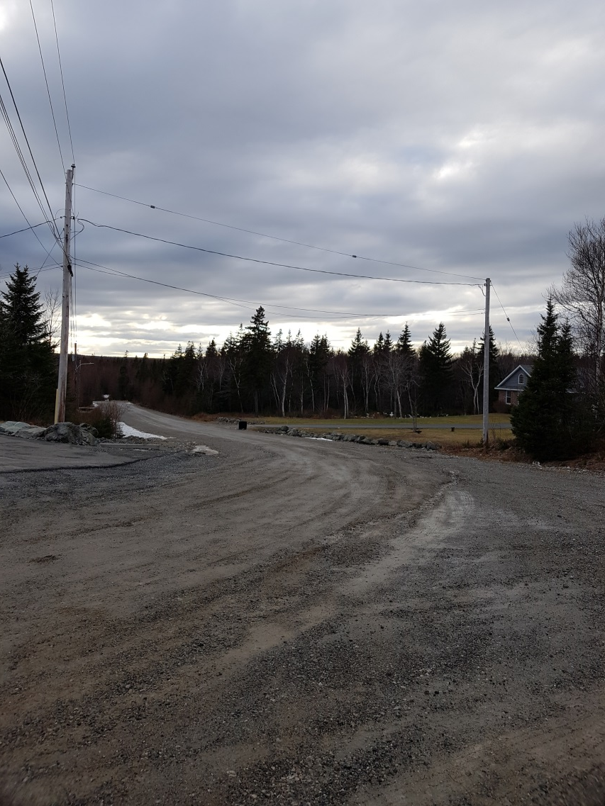
Proposed Gravel Roads Paving
There are 12 fully listed Cape Breton Regional Municipality that reside outside the former municipal town units which require initial paving. These 12 gravel roads are located un Districts 1,3,4,7,8,11 & 12.
We are operating under the basic principal of age & level of service in formulating our 2019 program.
There are 4 CBRM gravel roads proposed for rehabilitation across CBRM for this construction season.
Jenwood Drive District 11
Maglyn Drive District 11
Nearindale Drive District 11
Liscomb Point Drive District 12
General Capital
2019
Total $430,000

Slide 13
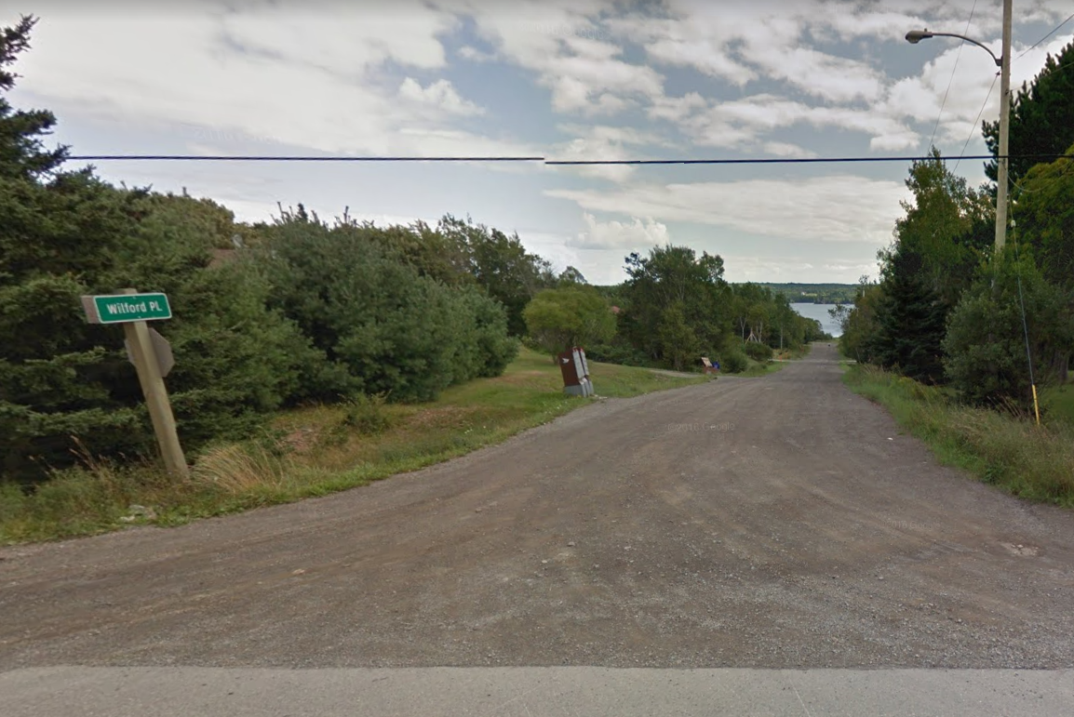
J Class Roads – Initial Paving
Since the early 2000’s, CBRM has entered into a 50-50 cost share agreement with the province of Nova Scotia for the initial paving of ‘J-Class’ roads that reside within CBRM. The CBRM selects and prioritizes the roads to be paved in the program. The road selection is based upon consultation with the District Councillor on a cycling basis, through each district which incorporates ‘J-Class’ roads. CBRM is currently working from a 2015 Council approved list. The current list has 4 roads remaining, involving approximately 1.37km
General Capital
2019

Slide 14
J Class Roads – Initial Paving
Priority Road District
1 Country Lane (Completed 2015) 8
2 Egan Ave, Cooks Lane (Completed 2015) 12
3 Berthelot Crescent, Staney Brea (Completed 2016) 3
4 Carmichael Drive, Johnson Crescent (Completed 2015) 4
5 O’Neil’s Road (Completed 2016) 4
6 Posure Street, Killarney Crescent, Kristen Court (Completed 2017) 7
7 Hanna Street, Karen Lynn Court, Nearingdale Drive (Completed 2018) 11
8 Harrietha Road 2
9 Wilfred Place, Earl’s Lane (Completed 2018), Gowrie Street 8
General Capital
2019
NSTIR has notified CBRM that Harrietha Road only has been approved for funding for this construction season.
Provincial - $143,393 CBRM - $143,393
Total $286,786

Slide 15
J Class Roads – Paving Program Phase 6 (2020)
District 12 Rhodena Drive (Victoria Mines) 0.26 km
Kilkenny Lake Road (Victoria Mines) 0.06 km
District 3 MacDonald Road (Scotia Lake) 1.60 km
District 4 Summerhill Drive (Deerfield) 0.03 km
Trunk 4 Loop (Sydney River) 0.20 km
Dobson Road (Westmount) 0.10 km
District 7 Marbern Street (Howie Center) 0.50 km
Lauren Lane (Howie Center) 0.31 km
Seaview Drive (Gabarus) 0.25 km
District 11 Guy Street (New Victoria) 0.21 km
Livingston Road (Lingan) 0.11 km
District 8 Franklyn Road (Catalone) 0.26 km
Seaview Lane (Little Lorraine) 0.25 km
Rosewood Heights (Mira) 0.40 km
Total 5.14 km
Roads Remaining Post this list:
District #7 – 2.08 km (8 Roads) District 38 – 0.71 km (3 Roads) District #3 – 0.92 km (3 Roads)
General Capital
2019

Slide 16
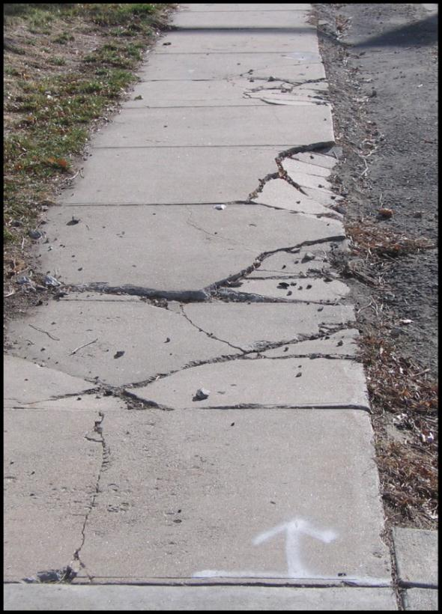
Sidewalks
Various replacement projects.
General Capital
2019
Total $1,000,000

Slide 17
Sidewalks Renewals
Central Division
Davenport Road
George Street
Cabot Street
St. Anne Street
Reeves Street
Cross Street
Kendall Street
Prince Street
Johnston Street
Forrest Street
East Division
King Edward Street
Prince Street
Gibbon Street
Fletcher Street
Center Street
North Division
Purves Street
Beech Street
Archibald Avenue
Atlantic Street
Main Street (Florence) Caledonia Street
General Capital
2019

Slide 18
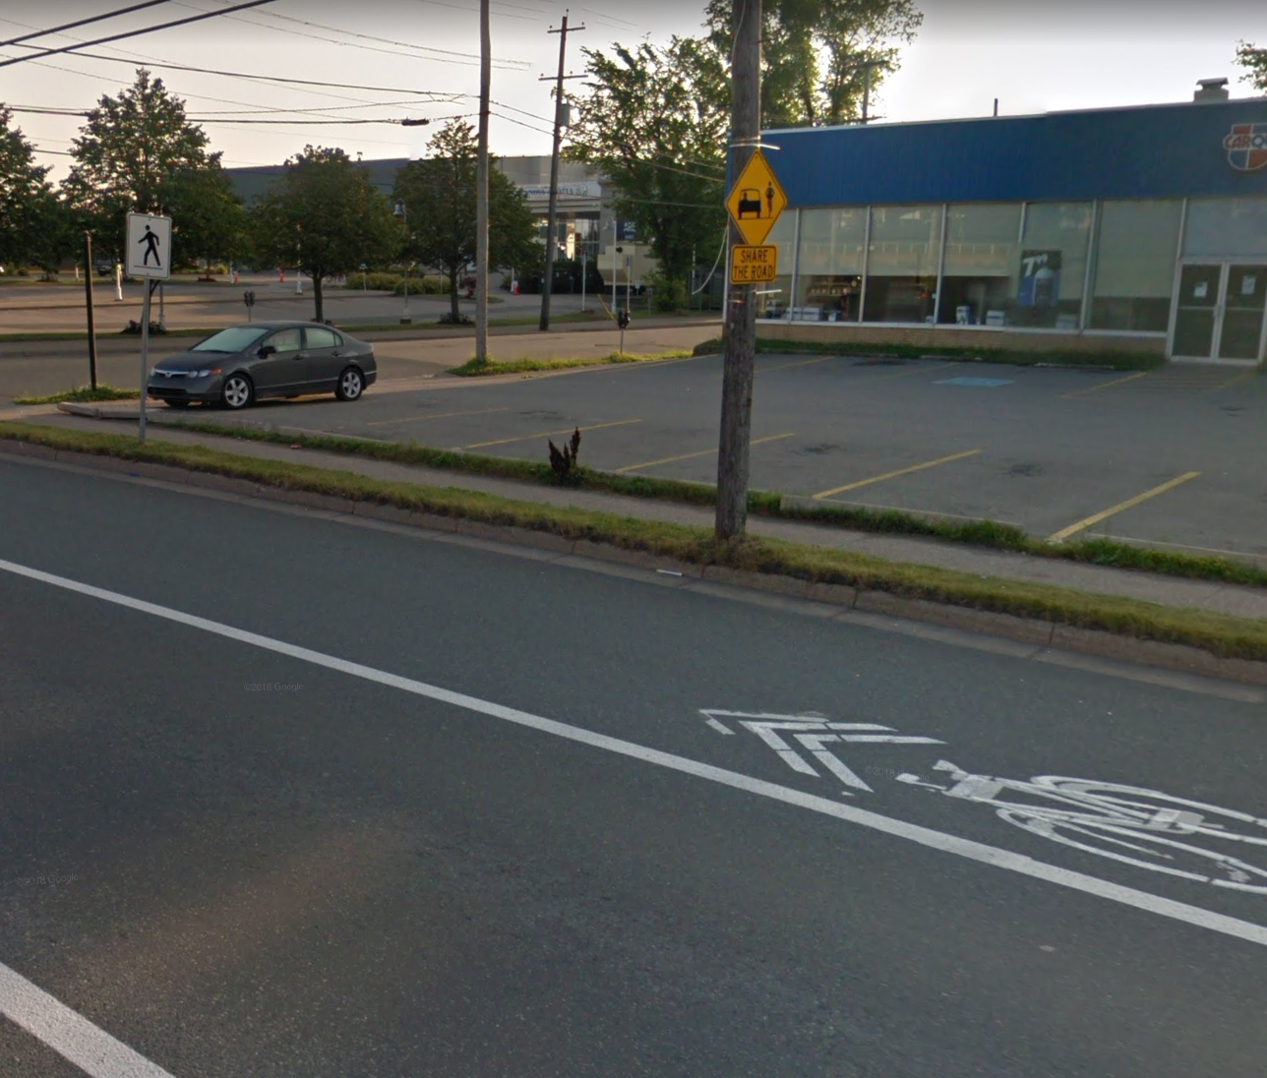

Active Transportation
In 2019-2020, two major projects are proposed. The installation of paved shoulders along the New Waterford Highway was identified as a signature project in the CBRM AT Plan and will take place in conjunction with the repaving of the highway by TIR. Paved shoulders were installed along the highway between New Victoria and Kilkenny Lake Road in 2015. This year the project will be completed with 1.2m paved shoulders between Kilkenny Lake Road and McKay Brook Bridge and wider paved shoulders between Egan Avenue and MacKay Brook Bridge (2m on one side and 1.2m on the other). CBRM will be paying 25% of the cost of the shoulder paving on this latter section.
The second major project involves the first phase of the Glace Bay – Dominion rail Trail. EXP Engineering is currently designing the project in a contract with Bicycle Nova Scotia. It is planned that the first phase will involve the construction of a paved 3m wide multi-use path and associated amenities in downtown Glace Bay between Main Street and the Sterling Mall..
In addition to the above two projects, work will be undertaken to upgrade existing trails, bike routes and walking routes. Completion of upgrades to the George Street bike lane in the North End of Sydney at a cost of approximately $45,000 in included in this total.
General Capital
2019
Project Cost ACOA Province CBRM
New Waterford Highway $600,000 - $450,000 $150,000
Paved shoulders
Trail/Bike/Walking Route $100,000 $33,333 $33,333 $33,333
Enhancements
Glace Bay Trail (Phase 1) $300,000 $100,000 $50,000 $150,000
Total $1,000,000

Slide 19
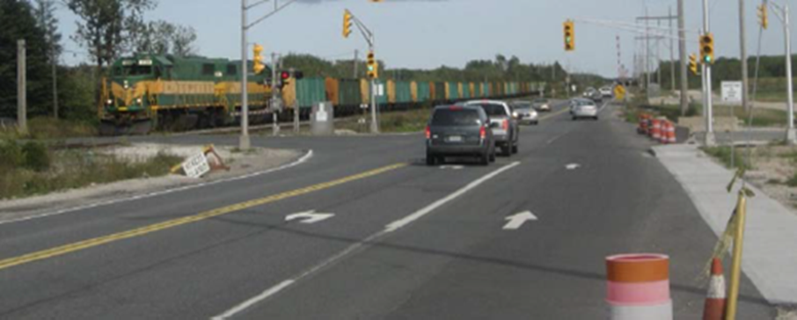
Spar / Lingan Road Rail Crossing Signals
Transport Canada - Rail Safety Improvement Program (RSIP)
This project involves upgrades to pedestrian infrastructure and to the interconnected traffic signals located at the Lingan Road railway crossing. These upgrades are in response to a Transport Canada Letter of Non-Compliance resulting from a recent inspection of this railway crossing.
A sidewalk at the rail crossing, along with the required pedestrian signals and timings and a painted crosswalk on SPAR Road are required to improve pedestrian safety at this location. Upgrading the traffic signals is required to reduce the likelihood of a vehicle becoming queued across the rail crossing. These measures will improve safety for pedestrian and vehicular traffic.
Funding Source | Amount | Percentage | Current Fiscal Breakdown Amount
Canada | $440,000 | 80 | $440,000
CBRM | $111,000 | 20 | $111,000
General Capital
2019

Slide 20
Wastewater – Sanitary Sewer I & I Reduction Program - $525,000
This program is a continuation of inflow and infiltration reduction work within any sewer catchment area in CBRM. Main areas of work are: Sewer system investigation, asset management and asset register building, sewer system upgrades and new storm sewer installations. To maximize our efforts, this funding in part or in full, could be used to leverage provincial funding for similar type work if a suitable program becomes available throughout the fiscal year.
Project One (1): I&I Reduction Pilot Project – Private Cross Connections $150,000
While CBRM will continue to identify and eliminate public infrastructure sources of I&I, this year will mark year one (1) of a multi-year campaign that includes a thorough look into private I&I sources such as the connection of foundation drainage systems (weeping tile) to sanitary service laterals. Based on historical standard practices and past field truthing exercises we suspect a large portion of I&I is coming from private cross connections. The objective of year one (1) is to retain the services of a qualified engineering consultant to segregate and prioritize sewer sheds based on I&I within the total sewer collection boundary of the Battery Point Wastewater Treatment Plant in Sydney. The results of this investigation will form the foundation of a multi-year I&I reduction campaign focusing on private cross connections. The estimated cost of this initial investigation is $150,000. A funding application for 50% of the project cost ($75,000) has been submitted to the Provincial Capital Assistance Program (PCAP).
Project Three (3): Asset Management System (AMS) - Installation & Implementation $172,000
Through the installation and implementation of asset management software, this year EPW will continue to improve our ability to manage assets, set priorities and develop long-term capital investment plans. Asset Management is the formal process of gathering information about our assets so that we can make more informed decisions about when and how we maintain and replace our assets so that we can deliver services that the public expects, at a cost we can afford. The key to asset management is access to, and analysis of accurate, current and relevant data and as equally important, properly cataloging maintenance events and maintaining a historical record on all assets. The purchase of Asset Management software and its implementation is an eligible expense under the Federal Gas Tax Fund. Looking forward, the annual estimated expense of $90,000 for software upgrades admin support and technical support will fall under the EPW operating budget starting in 2020-21.
General Capital
2019
Project Two (2): I&I Reduction Projects – Public infrastructure improvements $203,000
This project will place a focus on the elimination of public infrastructure sources of I&I such as catch basins disconnections, replacement of deteriorated sanitary sewers and the installation of storm sewers.
Funding Source | Amount | Percentage
Federal (Gas Tax) | $450,000 | 85
Provincial | 75,000 | 15
CBRM | - | -

Slide 21
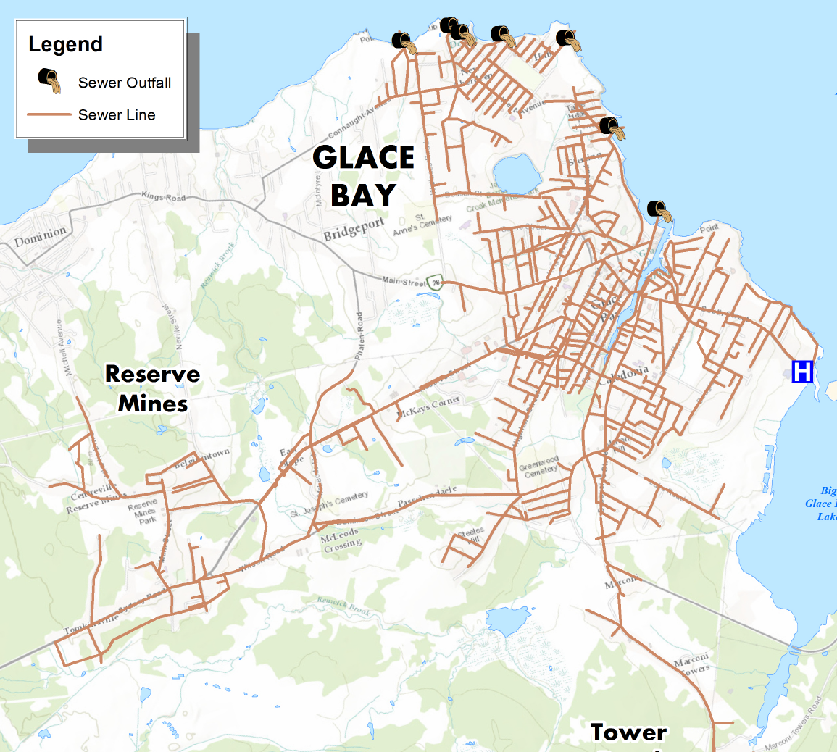
Wastewater Treatment Infrastructure Project (ICIP)
ICIP Application - Wastewater Treatment Glace Bay /Port Morien, Battery Point UV and Lagoon Upgrades
$98,049,021
a) High Risk Wastewater Treatment System Project (ICIP)
Glace Bay & Port Morien
$1,000,000
Federal Wastewater System Regulations (WSER) have been enforced since 2012. There is now an immediate need to address high-risk wastewater systems which have a compliance deadline of December 31st, 2020. this deadline cannot be achieved, however, CBRM must continue working towards the goal of wastewater compliance by taking advantage of funding opportunities when they are available. The ERA and Preliminary Design Project has progressed well, putting CBRM in an excellent position to transition into detailed design and construction by the spring of 2019. As described below, Harbour Engineering Joint Venture has prepared a project delivery schedule for these systems. This project will be delivered over seven fiscal years.
2019-20 Total Estimated Expenditure - $1,000,000
2020-21 Total Estimated Expenditure - $1,500,000
2021-22 Total Estimated Expenditure - $2,000,000
2022-23 Total Estimated Expenditure - $17,200,000
2023-24 Total Estimated Expenditure - $14,119,184
2024-25 Total Estimated Expenditure - $14,119,184
2025-26 Total Estimated Expenditure - $14,119,184
2026-27 Total Estimated Expenditure – $14,119,184
2027-28 Total Estimated Expenditure - $16,123,120
General Capital
2019
Funding Source | Amount | Percentage | Current Fiscal Breakdown Amount
Federal | $37,658,868 | 40 | $400,000
Provincial | $31,379,251 | 33.33 | $333,300
CBRM | $25,262,496 | 26.67 | $266,700

Slide 22
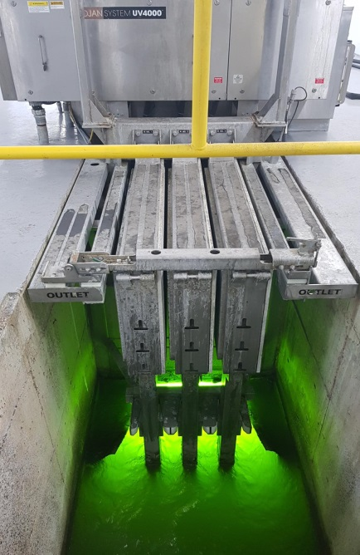
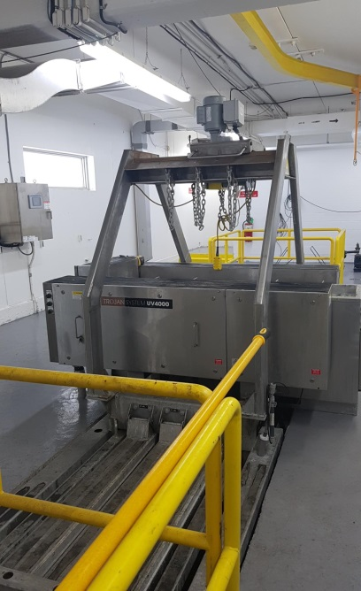
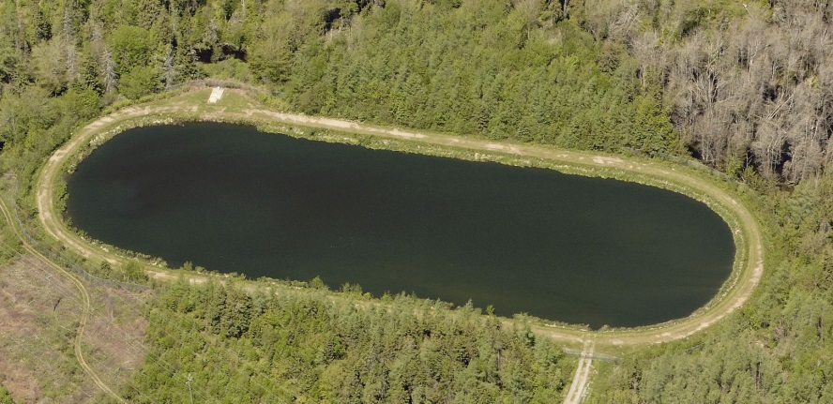
Wastewater Treatment Infrastructure Project (ICIP)
b) Battery Point UV System Replacement Project (ICIP)
$1,473,853
The final stage of treatment at the Battery Point Wastewater Treatment Plant is disinfection. The disinfection equipment at this site consists of a Trojan UV 4000plus system which is now discontinued and has reached the end of it’s useful life. To maintain adequate disinfection and to avoid the possibility of a major equipment failure and process upset, the UV systems at Battery Point needs to be replaced. The proposed UV replacement project will occur during the 2019-20 fiscal year.
Funding Source | Amount | Percentage | Current Fiscal Breakdown Amount
Federal | $589,541 | 40 | $589,541
Provincial | $491,235 | 33.33 | $491,235
CBRM | $393,096 | 26.67 | $393,076
c) Wastewater Treatment Lagoon Upgrade Project (ICIP)
$1,166,769
Disinfection Upgrades at four of our Wastewater Treatment Lagoons are necessary due to upcoming federal regulations for residual chlorine – Deadline of January 1st, 2021. This project will be delivered over two fiscal years starting in the spring of 2019. Year One will include the Tower Road Lagoon and the Meadowbrook Lagoon UV system installations. Year Two will include the Southwest Brook Lagoon and the Centerville Lagoon UV system installations
2019-20 Expenditure - $1,166,769
2020-21 Expenditure - $1,107,782
General Capital
2019
Funding Source | Amount | Percentage | Current Fiscal Breakdown Amount
Federal | $909,820 | 40 | $466,707
Provincial | $758,108 | 33.33 | $388,884
CBRM | $606,622 | 26.67 | $311,177

Slide 23
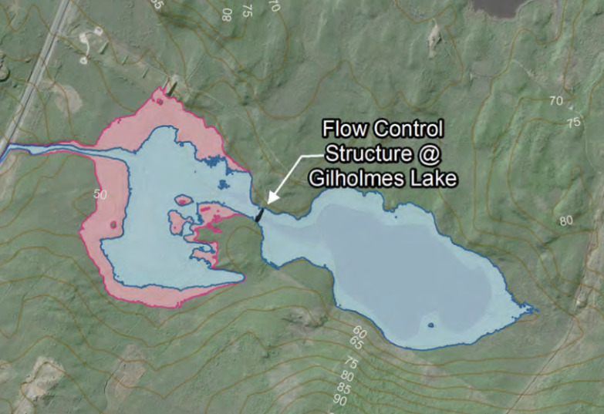
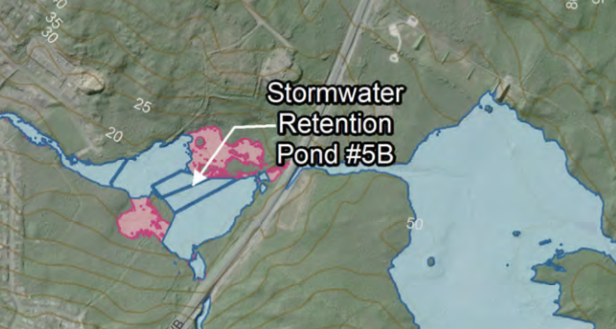
Floodwater Intensity Mitigation Project (DFA Funding)
Gilhomes Lake & Detailed Design of Pond 5 (DFAA) $600,175
New Project
The purpose of this funding is to construct the Gilhomes Lake Flow Control Structure and part of Pond 5B which are part of CBCLs recommended flood reduction option number 15 established through the 2017 Wash Brook Flood Containment and Intensity Mitigation Project.
2019-20 estimated expenditure = $ 600,175
2020-21 estimated expenditure = $2,006,975
Funding Source | Amount | Percentage | Current Fiscal Breakdown Amount
Public Safety CA (DFA) | $2,500,000 | 96 | $585,617
Federal (Gas Tax) | $107,150 | 4 | $14,558
CBRM | - | - | -
General Capital
2019

Slide 24
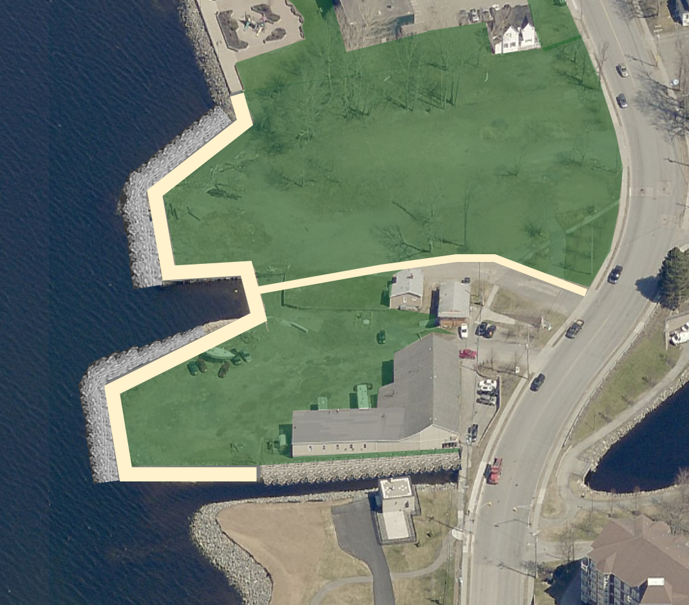
Boardwalk Expansion – Phase 6
General Capital
2019
Proposed Boardwalk Expansion Phase 6
Total Cost $3,200,000
Year 1 of 2 $200,000

Slide 25
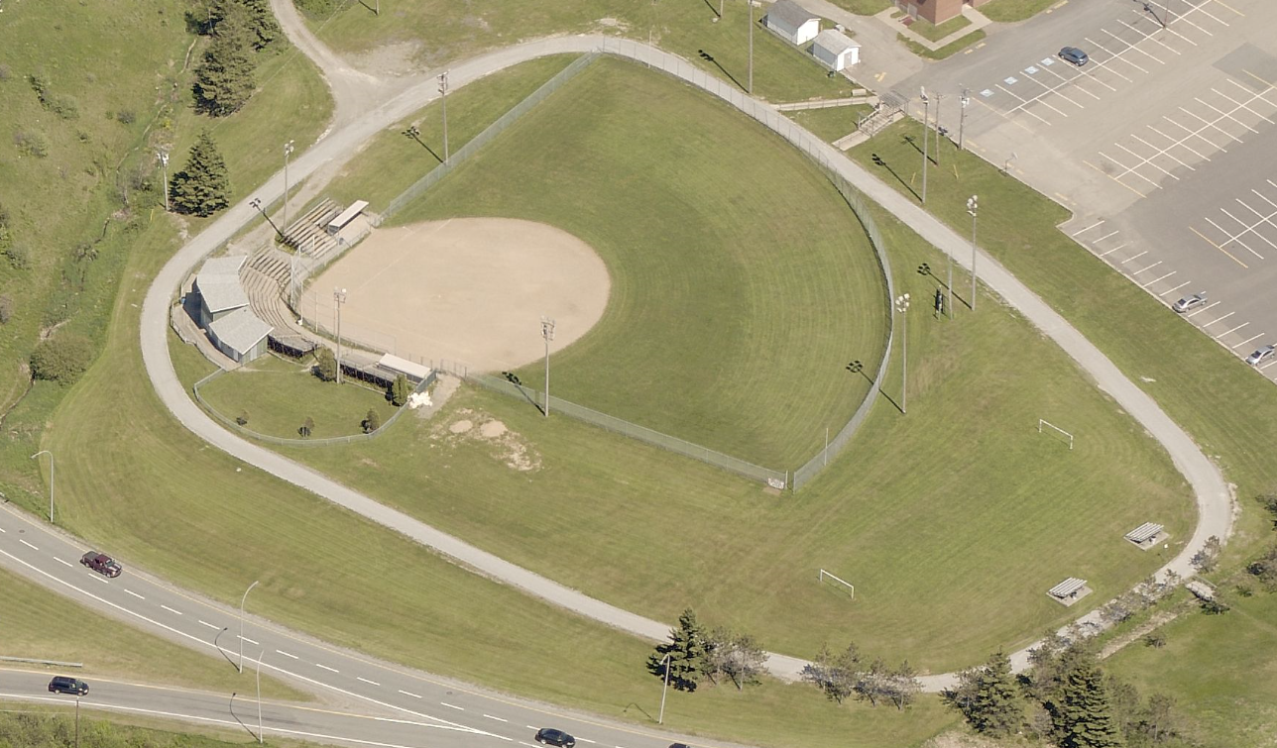
Parks & Grounds
General Capital
2019
Various sports field upgrades.
Total $150,000

Slide 26
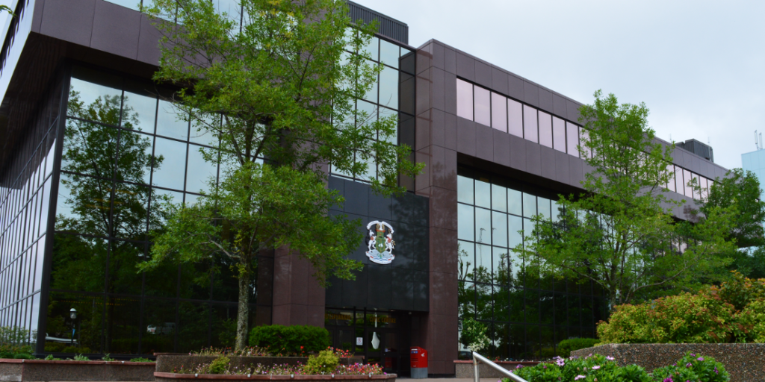
Buildings – General Upgrades
Civic Centre Air Coils Replacement $20,000
Massey Drive Air Handling Unit $98,000
Replacement
Dr. Dan S. Natheson Heat Pumps & $75,000
Citizen Service Subsidence
Centre/Police
Bus Shelters Central, North, East $100,000
Transit Building General Repairs $75,000
Fire – Buildings General Repairs $100,000
Energy Efficiencies $100,000
General Capital
2019
Total $568,000

Slide 27
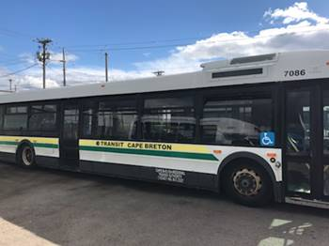
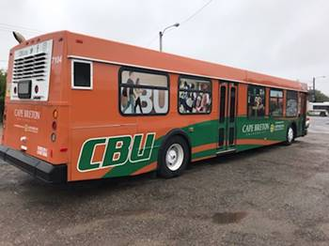
Transit
General Capital
2019
Provincial Grant $585,000
CBRM $415,000
Total $1,000,000

Slide 28
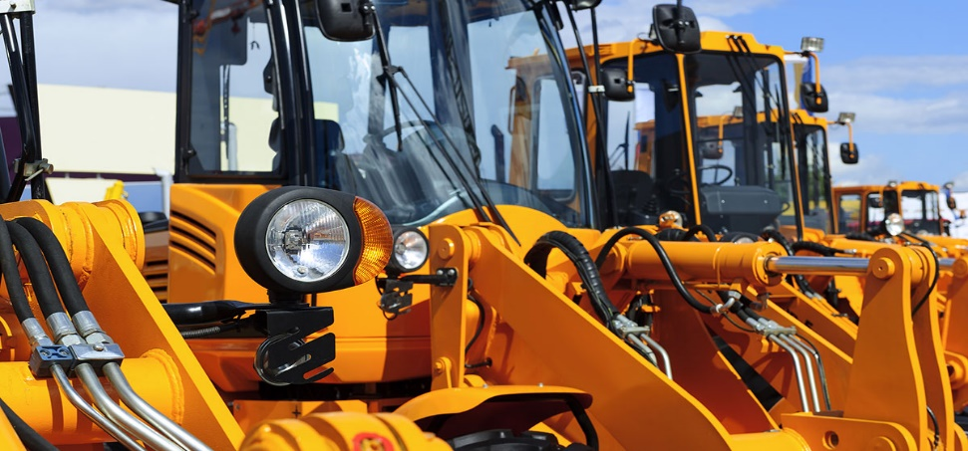
Fleet Replacement
General Capital
2019
Water Utility $650,000
CBRM $850,000
Total $1,500,000

Slide 29
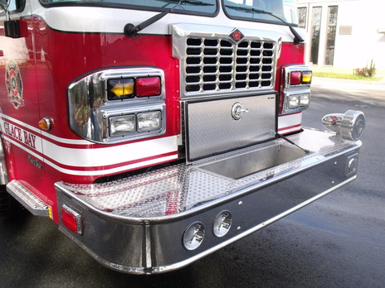
Fire Services
2019 Pumper, Marion Bridge $393000
2019 Pumper/Tanker, Florence $375,077
2019 Pumper/Tanker, Westmount $384,077
Note: There is no cascading of trucks in this year’s Fleet Plan as all three (3) apparatus are being removed from service due to age, 25 years, thus the Underwriter’s requirement for Emergency Apparatus.
Commercial Air Compressor (1) $31,286
General Capital
2019
Note: Three (3) Air Compressors currently required, 1 per year x 3 years
These compressors fill Firefighter air packs and we currently have three (3) in our system that have reached life expectancy and require replacement. These compressors are strategically placed throughout our thirty-five (35) volunteer, composite and career departments to allow for complete Municipal coverage.
Total $1,183,980

Slide 30

Prepared By
Cape Breton
Regional Municipality
Engineering

