Slide 1

VICE CHAIRS:
Paul MacDonald
Mary Tulle
Jennifer Collins

Slide 2
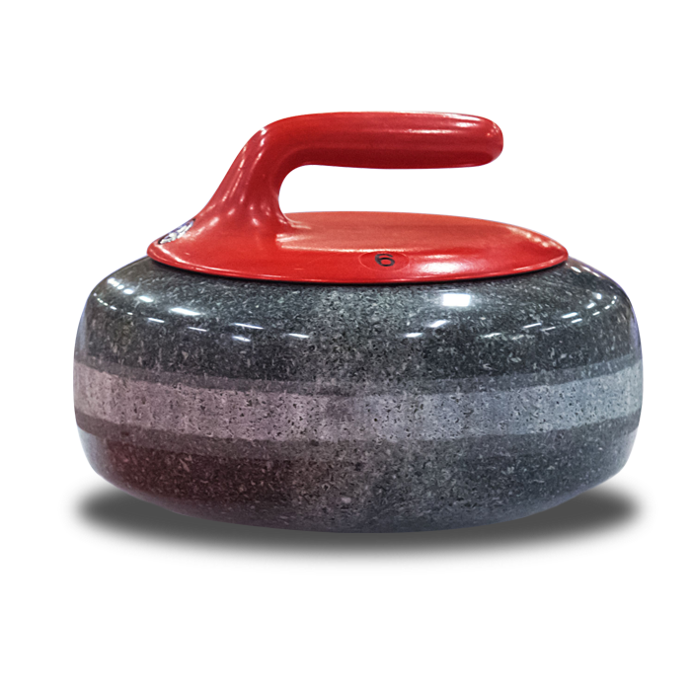
EVENT RECAP
The 2019 Scotties Tournament Of Hearts took place in Sydney Nova Scotia from February 16 to the 24, 2019 at Centre 200.
Over the 9 days of competition, Sydney hosted sixteen teams (14-member provinces and territories, Team Canada and a wild card team) in two pools of eight.
The 9 day event attracted nearly 14,000 unique spectators.
Visitors were asked about the importance of the 2019 Scotties Tournament Of Hearts in their decision to travel to Sydney. The results show that this event was the main driver for 83% of respondents, with an average importance of 9.6/10.
In hosting the 2019 Scotties Tournament Of Hearts, the event organizers spent approximately $1.2 million on various goods and services to ensure the successful operation of the event.

Slide 3
NUMBERS
The combined spending of out-of-town spectators, participants, media, sponsors, and other people who visited Sydney for the 2019 Scotties Tournament Of Hearts, in combination with the expenditures made by the organizers of the event, totaled:
$5.2 million
$7.83 million in economic activity (industry output) in Nova Scotia,
$6.94 million of economic activity in Sydney

Slide 4
NUMBERS
These expenditures supported:
$2.6 million in wages and salaries in the province and
$2.3 million in wages and salaries were supported in Sydney
The total net economic activity (GDP) generated by the
2019 Scotties Tournament Of Hearts was:
• $4.95 million for Canada as a whole
• $4.1 million for the Province of Nova Scotia
• $3.4 million for Sydney
The 2019 Scotties Tournament Of Hearts supported tax revenues totaling $1.5 million across Canada.

Slide 5
ATTENDANCE & MEDIA
Attendance for the week was just under 47,000 people
85% came from Nova Scotia and of that number just over 40% came from the CBRM
TSN provided coverage of all of the draws which brought a great deal of exposure to the CBRM. They were impressed by C200 and the area in general. The overall average per minute audience (AMA) was 352,000. The playoffs and the finals had a 574,000 AMA.
The gold medal final average was 762,00 AMA compared to 620,000 the previous year.
At one point during the final it was recorded that over 1M people were tuned in. One final comparison overall cumulative numbers STOH this year 6,696,000. This was higher that Penticton in 2018 6,523,000 and St. Catherines in 2017 6,208,000.
It is also noteworthy that the STOH also outdrew The Brier final in Brandon 671,000.

Slide 6
VOLUNTEERS: The Heart
There were 370 volunteers led by 3 vice-chairs and 12 directors.
Most typically worked between 16 and 25 hours for the week although the ice crew probably worked closer to 40-60 hours for the week. Each paid a $100 commitment fee.
The breakdown of the volunteers was 351 from Nova Scotia, 209 of those from the CBRM.
71 from the Sydney Curling Club,
24 from the Schooner Club and
3 from Baddeck
Our volunteers were outstanding during the event and performed well beyond what was required. Feedback from athletes, officials and the host media partner was extremely positive.

Slide 7
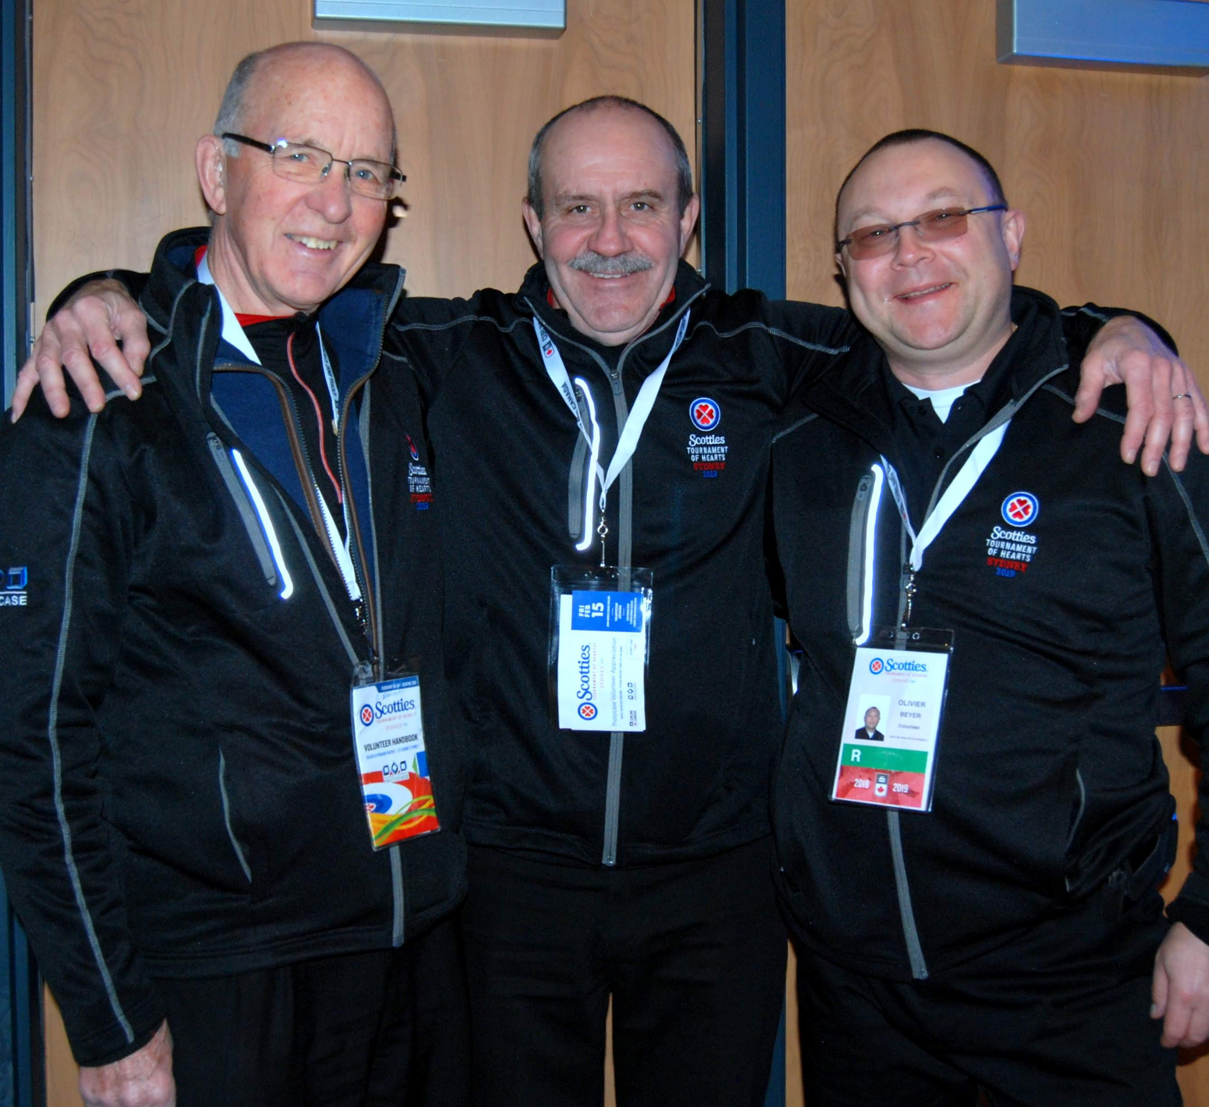
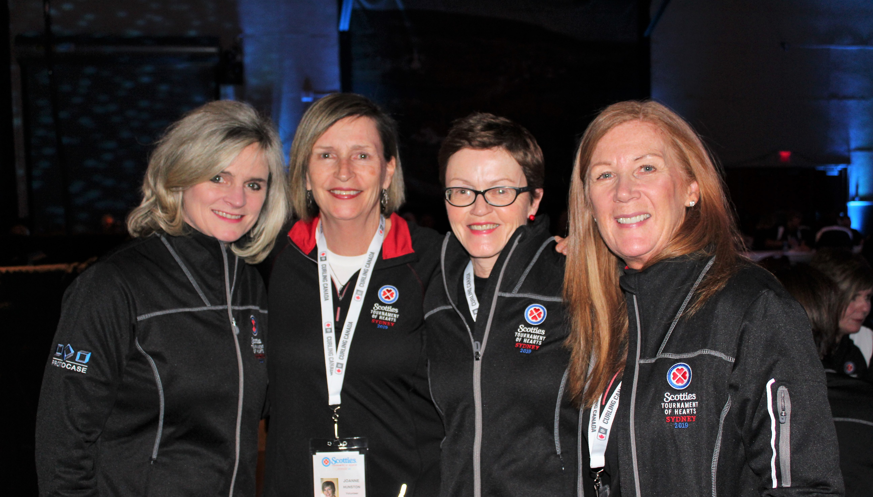


Slide 8
SUMMARY
of the 2019 Scotties Tournament of Hearts – Sydney, NS
2019 Scotties Tournament of Hearts – Sydney – Key Facts & Figures
$5,206,611 Of Initial Expenditures | $4,008,813 Of visitor spending attributed to event | $6,936,604 Overall economic activity in Sydney area | $7,826,151 Overall economic activity in Nova Scotia | $9,648,037 Overall economic activity in Canada
5,042 Out of town visitors | $2,259,602 Of wages and salaries supported locally | $4,068,943 Total boost to provincial GDP | $1,635,931 In taxes supported across Canada | 55 Local jobs supported

Slide 9
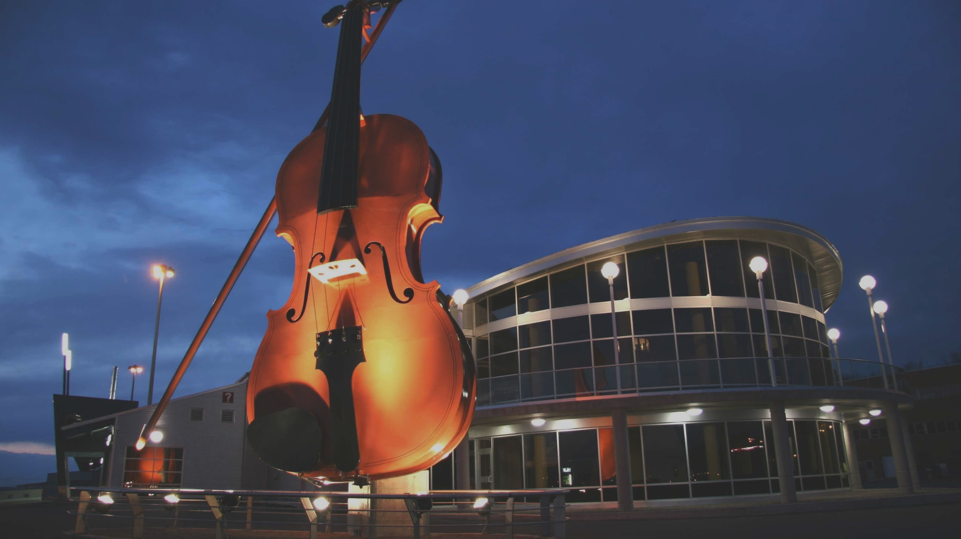
“Cape Breton Island set the tone for another memorable Scotties”
-TSN

